Slide 1
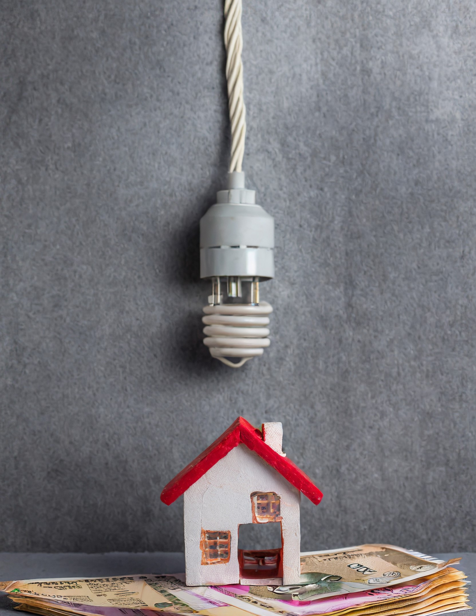
HOME ENERGY Analysis : smart choices
Goutham K G

Slide 2

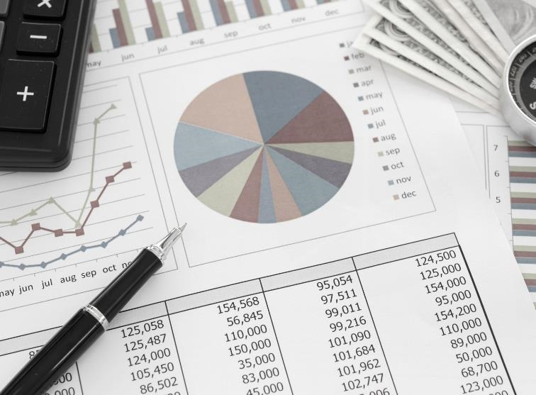
Introduction
Explore insights into household electricity consumption through comprehensive analysis.
Understand patterns, trends, and factors influencing energy usage.
Uncover key contributors to the electricity bill.
Identify trends and correlations to optimize energy efficiency.
Inform better energy management decisions.

Slide 3
Timeline
Data collection
Collected the dataset regarding the bills and electricity appliance using old bills and inquiry.
Analysis
To gain insights, done varies analysis like correlation analysis and exploratory analysis using python and power bi tool.
Insights
Obtain the insights from the corresponding analysis with patterns, factors.
Conclusion
Recommendation
With all the analysis and insights that obtained, finally came into a conclusion.
Recommend better energy management decisions.

Slide 4
Dataset
The dataset table (165x15) contains the date of bill, bill amount for every month and the details(count) of other 13 electric appliance.
DATE | BILL | FILAMENT BULB | . . . | BORE WELL MOTOR
01-Jan-10 | 119.0166 | 7 | . . . | 0
01-Feb-10 | 110.533 | 7 | . . . | 0
. . . | . . . | . . . | . . . | . . .
01-Sep-23 | 442.439 | 0 | . . . | 1

Slide 5



Type of Bulb used in last 10 Years
Type of bulb has a major influence in electric bill.
The most used bulb is CFL. And least is Filament bulb.
The variance in high when switched from Filament to CFL. And from CFL to LED too.
. ​
LED BULB
CFL BULB
FILAMENT BULB

Slide 6
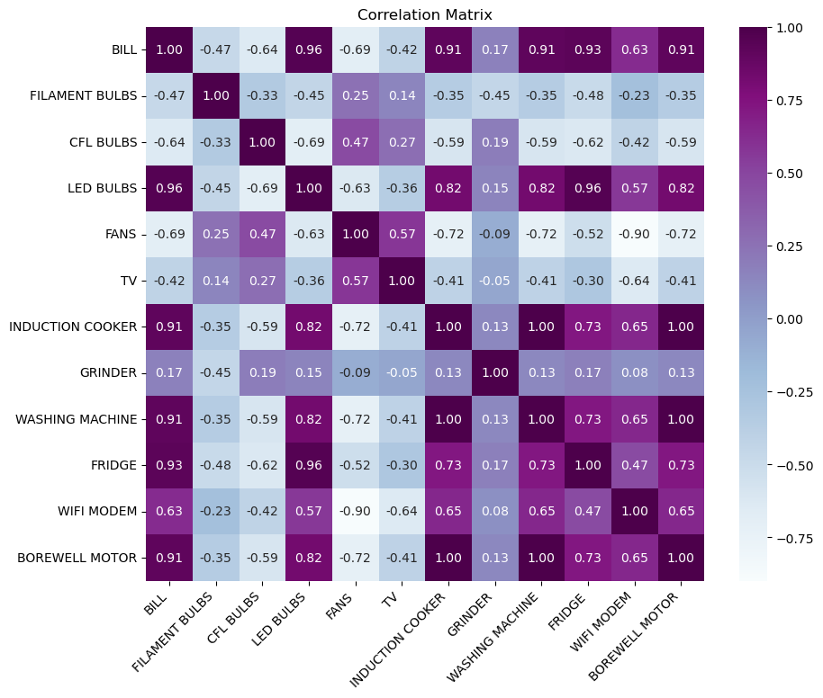
Correlation Heatmap
It appears that LED Bulbs, Washing Machine, Fridge and Borewell Motor are more correlated to Bill.
Except LED bulb is negatively correlated.
.
. ​

Slide 7
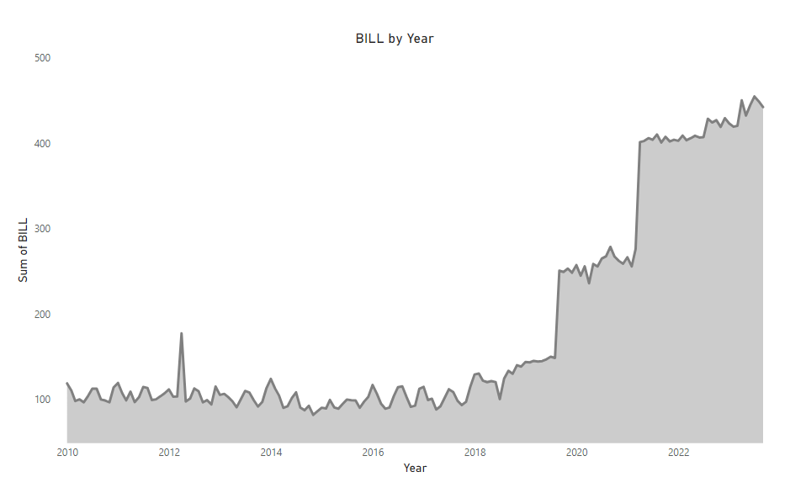
Line graph for Bill over Time
This line plot shows the variation of bill amount over time.
It depicting that slightly increase in amount in 2012 and 2019 followed by 2020,2022.

Slide 8
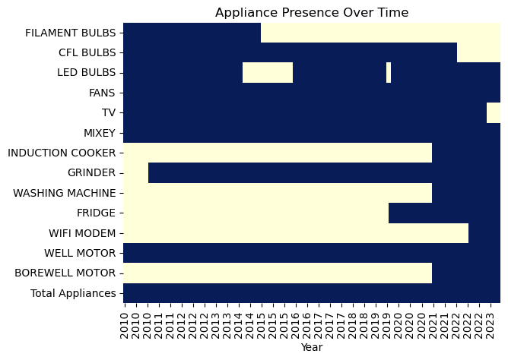
Availability of appliance over time
It shows the year which each electric appliance appeared in the house.
Blue part indicates the presence.
We clearly understand that which appliance cause more amount of bill by cross check of line plot and this visualization.
​

Slide 9
Conclusion
Bulb impact
Changes in Bill
The type of light bulbs used significantly influences the electricity bill.
Switching from old bulbs to CFL and LED bulbs affects the bill.
Noticed slight bill increases in 2012, 2019, 2020, and 2022.
Appliance Timeline
Appliance connection
In 2019, the addition of a Fridge impacted the bill. Borewell motor and Washing Machine appeared in 2021, contributing to changes in energy usage.
Washing Machine, Fridge, and LED Bulbs are closely tied to the bill. Interestingly, having more LED bulbs seems to lower the bill.

Slide 10

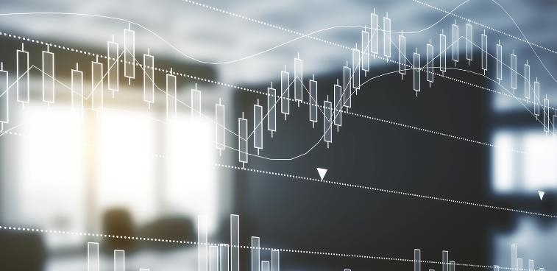

Recommendation
Monitor High-Impact Appliances:
Keep an eye on appliances like the Fridge, Washing Machine, and Borewell Motor to manage their usage efficiently.
Explore Smart Home Solutions:
Investigate smart home technologies for better control and scheduling of appliances.

Slide 11
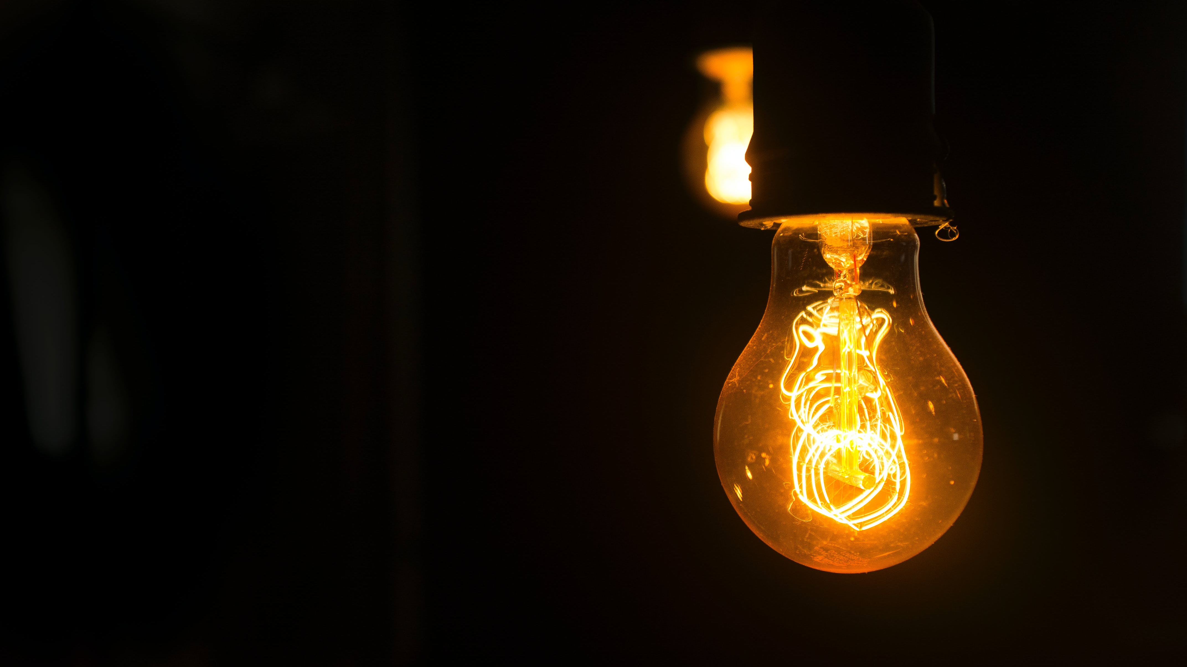
“A brighter, smarter energy future begins with small, mindful steps.”

Slide 12

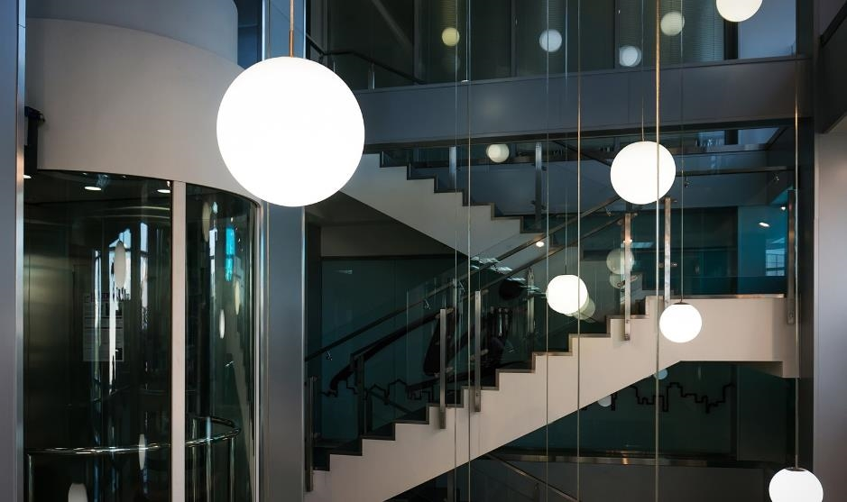
THANK YOU
Goutham K G
gouthamktm707@gmail.com

